Slide 1
Met Data Analysis
COMP 4447 – Winter 2025
Gabe Barela & Reid Holben
Notes:
REID SLIDE: Introduction

Slide 2

Research Question
Examine the evolution of the Metropolitan Museum of Art’s collection via accession date and object history dates
See how well based on limited data can the museum’s classification system be replicated
Dataset from museum’s open access portal – last updated June 17th 2023. Minimal metadata available.
Notes:
REID SLIDE: This is the overview: evolution of the museum’s collection over time, seeing if classification system can be predicted.

Slide 3
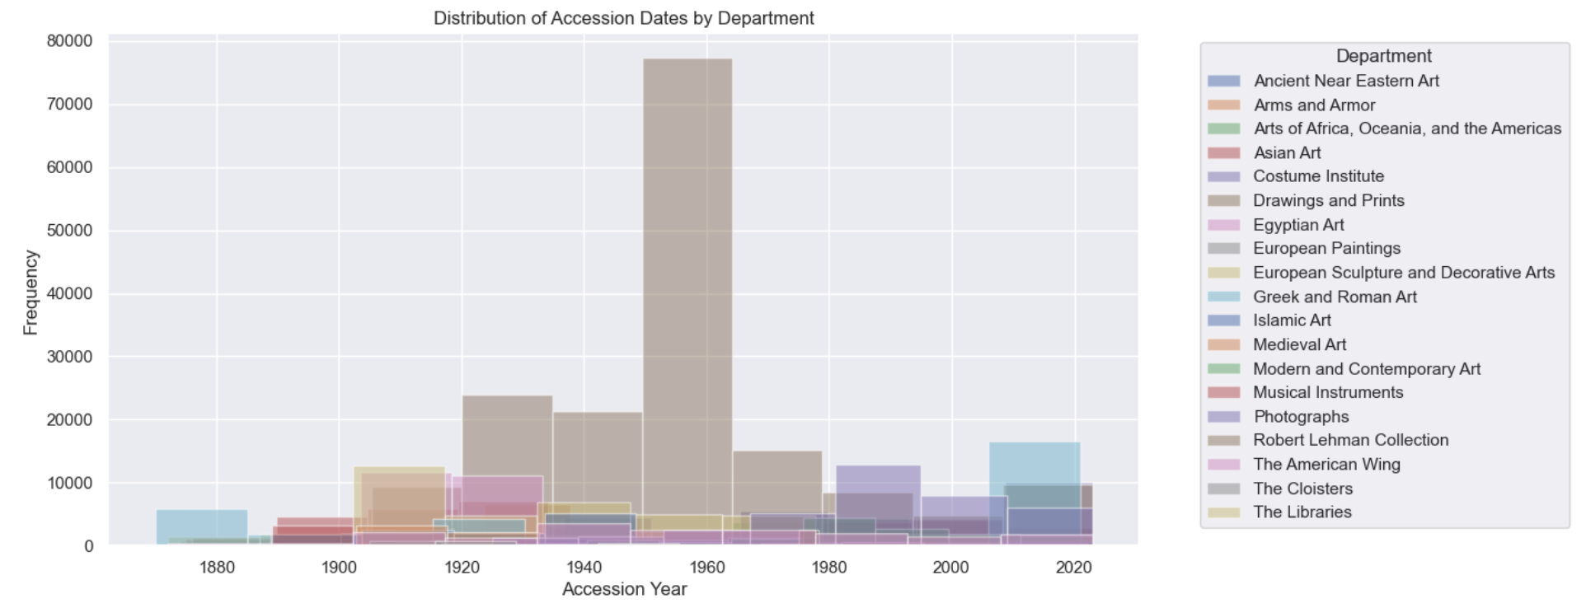
Data Exploration
There were several columns that were object datatypes.
Datatype conversions were needed to allow us to further analyze the data.
i.e.: some dates as textual ranges, some as specific dates, others as strings.
Once data was turned numeric, we still faced issues that had to be addressed.
Notes:
GABE SLIDE: Discuss initial feature engineering and need for data conversion
Combined Insights from the Graphs
Distribution of Accession Dates by Department
The graph titled "Distribution of Accession Dates by Department" provides insights into the collection's acquisition patterns:
Acquisition Trends: The timeline spans from 1880 to 2020, showing periods of high acquisition activity.
Departmental Acquisition Patterns: Different departments have distinct acquisition trends.
Egyptian Art: High frequency of acquisitions between the late 1900s up until 1940, slowly trailing off but continuing today.
Modern and Contemporary Art: Significant increase in acquisitions in recent years.
Ancient Near Eastern Art: Consistent acquisition activity over the years.
Other Departments: Varied acquisition patterns reflecting diverse strategies.

Slide 4
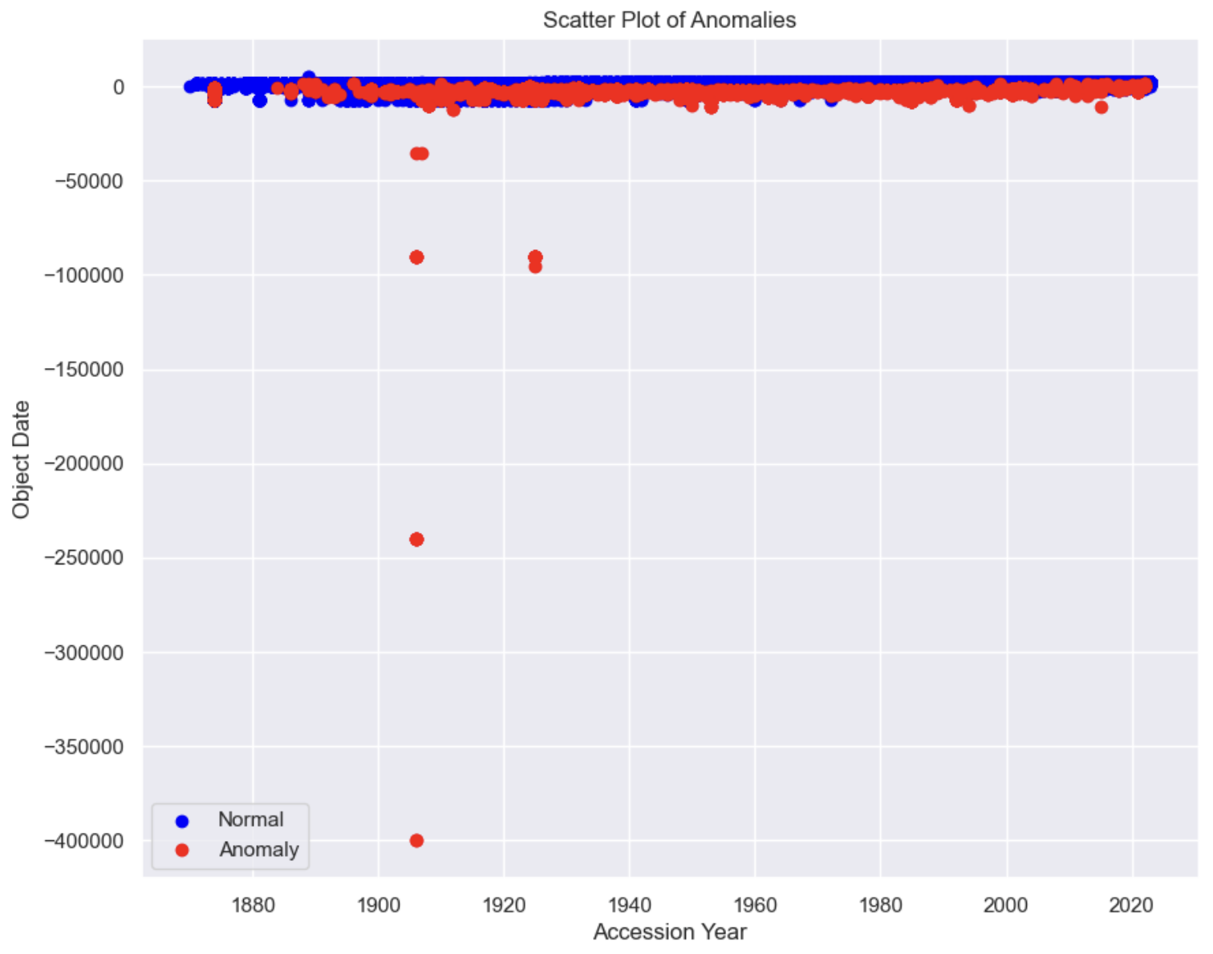
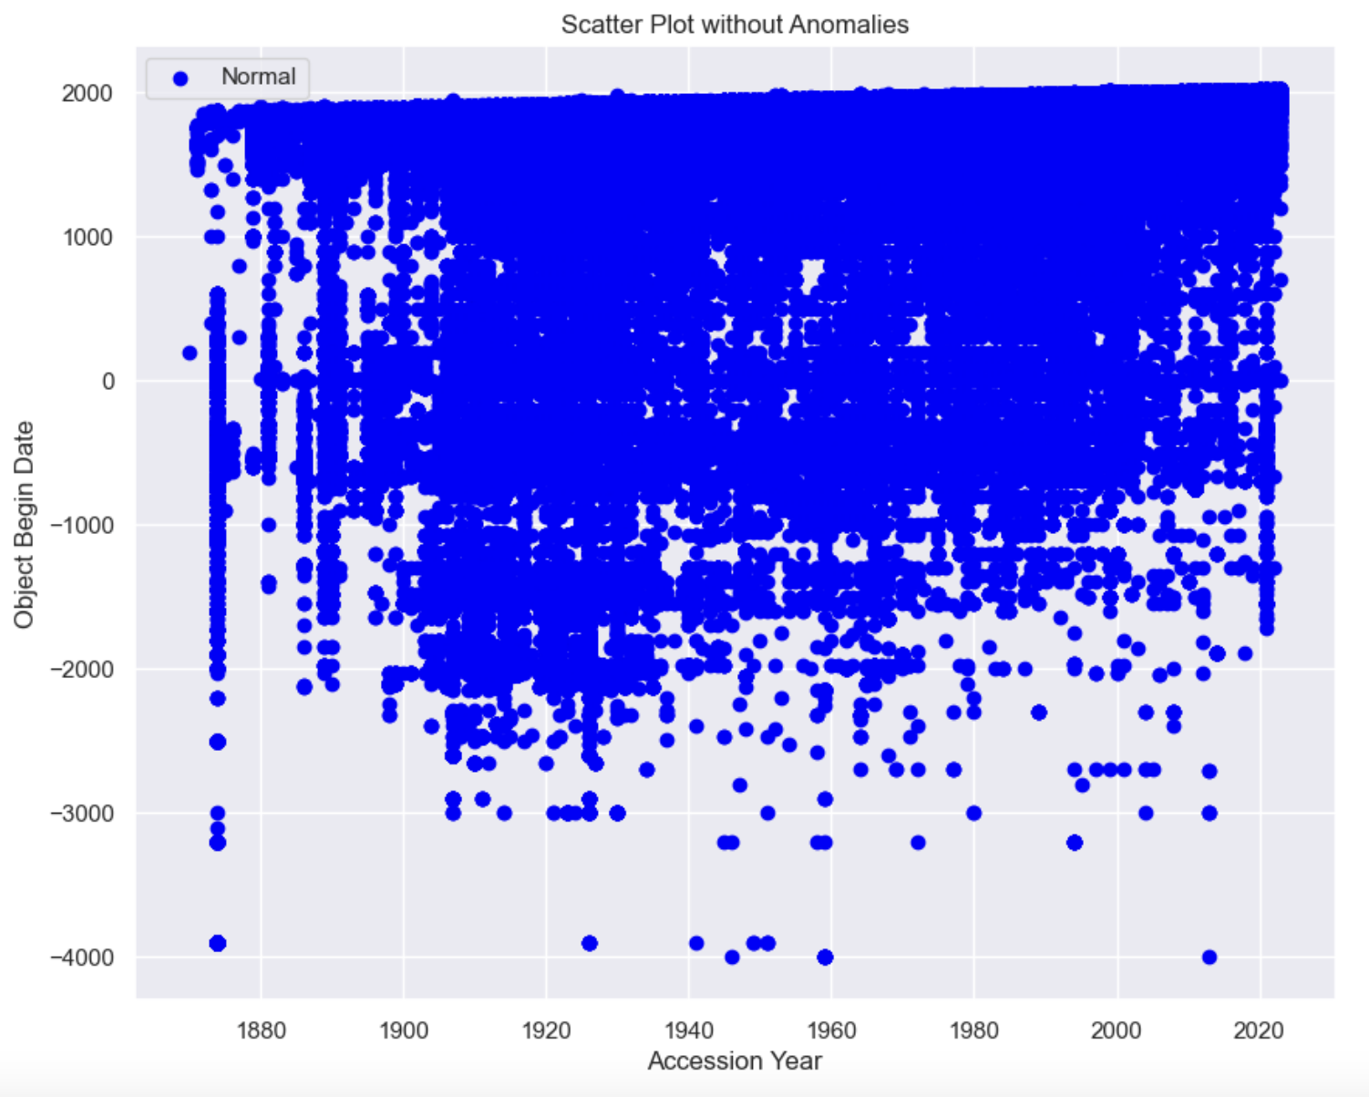
Outlier Detection
Notes:
GABE SLIDE: notes below on outliers. Anomalies pre and post: huge difference
Reasons for Data Removal
The data points flagged and removed as anomalies were identified based on several criteria:
Extreme Values:
Data points with values significantly higher or lower than the rest of the dataset. For example, 'Object Date' values far outside the typical range (e.g., -7000).
Inconsistent Data:
Rows with contradictory information, such as an 'Object Begin Date' that is later than the 'Object End Date'.
Rare Combinations:
Uncommon combinations of features that do not appear frequently in the dataset. For example, specific 'Department' values with unusual 'AccessionYear' values.
Missing or Default Values:
Rows with many missing values or default values (e.g., 0 or NaN) in features that usually contain meaningful data.
The code uses the Isolation Forest algorithm to detect anomalies in the dataset. It converts the 'Department' column to numerical data with one-hot encoding, ensures all columns are numeric, and saves a pre-encoded version of the dataset. The Isolation Forest model, with a contamination rate of 0.01, is fitted to the cleaned data to predict anomalies, which are added as a new 'Anomaly' column. Anomalous rows are filtered and displayed. This process flags anomalies due to extreme values, inconsistent data, rare combinations, or missing/default values, improving dataset quality by removing outliers and enhancing the accuracy of subsequent analysis and modeling.

Slide 5
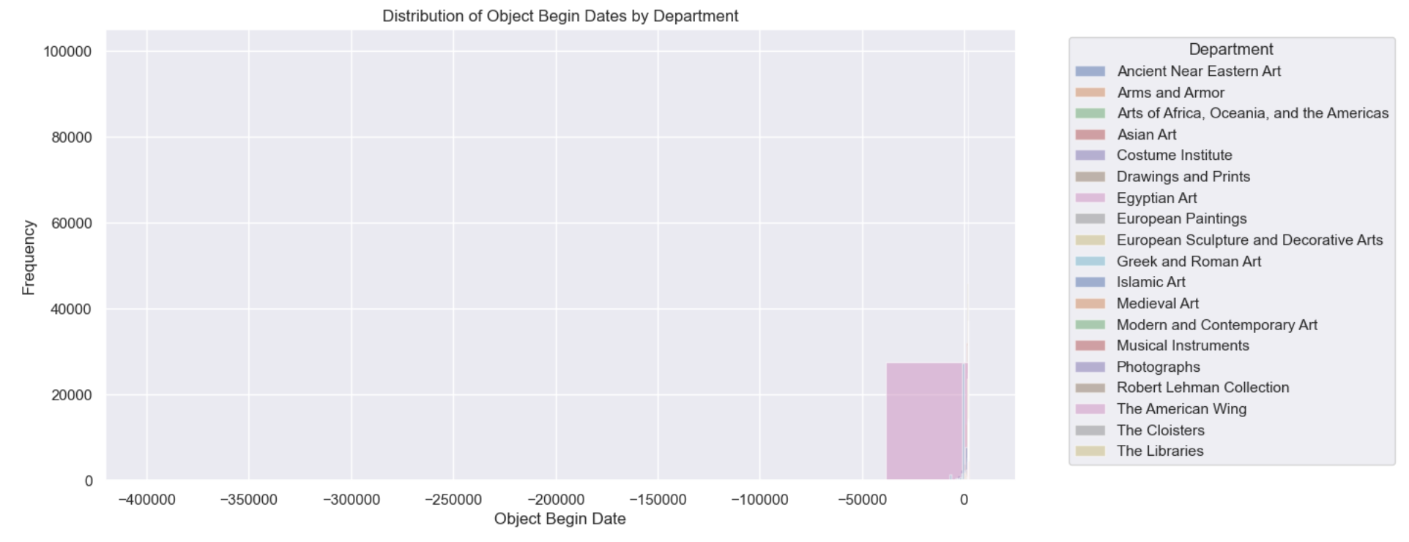
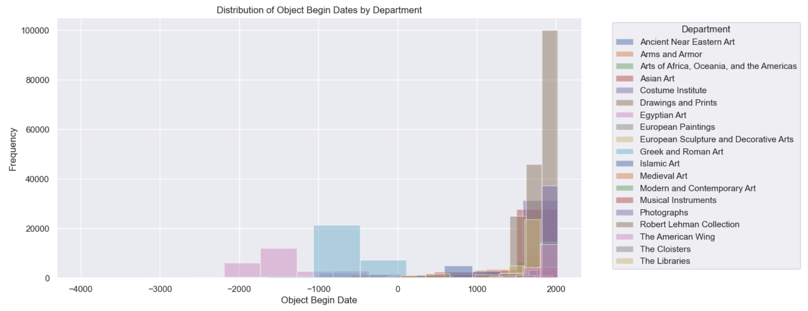
Post-Outliers\Anomaly Removal
With only 1% of data removed post-isolation forest, there is a noticeable improvement in the legibility of some of the graphs, particularly the Object Begin Date.
The following plots shows a comparison of pre and post outliers\anomaly removal, highlighting the changes in object begin date and frequency.
Pre-Outliers\Anomaly Removal
Notes:
GABE SLIDE: Post-Outliers you can see the object begin date graph is now significantly more legible.
Comparison and Summary
Historical Range:
Pre-Outliers Removal: Covers a wide range from -400,000 to 0, including very ancient objects.
Post-Outliers Removal: Focuses on a narrower range from -4000 to 2000, removing extreme ancient dates.
Frequency Distribution:
Pre-Outliers Removal: Significant variation in object begin dates, with some departments having very ancient objects.
Post-Outliers Removal: More balanced distribution, with fewer extreme values and a more consistent representation across departments.
Data Quality:
Post-Outliers Removal: Improved dataset quality by removing outliers, making it more representative of typical data patterns.
Pre-Outliers Removal: Includes outliers, which may skew the analysis and representation of the dataset.
Conclusion
The removal of outliers and anomalies has led to a more balanced and consistent dataset, focusing on a narrower historical range and improving the overall quality and reliability of the data for subsequent analysis or modeling tasks. This process enhances the accuracy of insights derived from the dataset, making it more representative of typical data patterns.

Slide 6
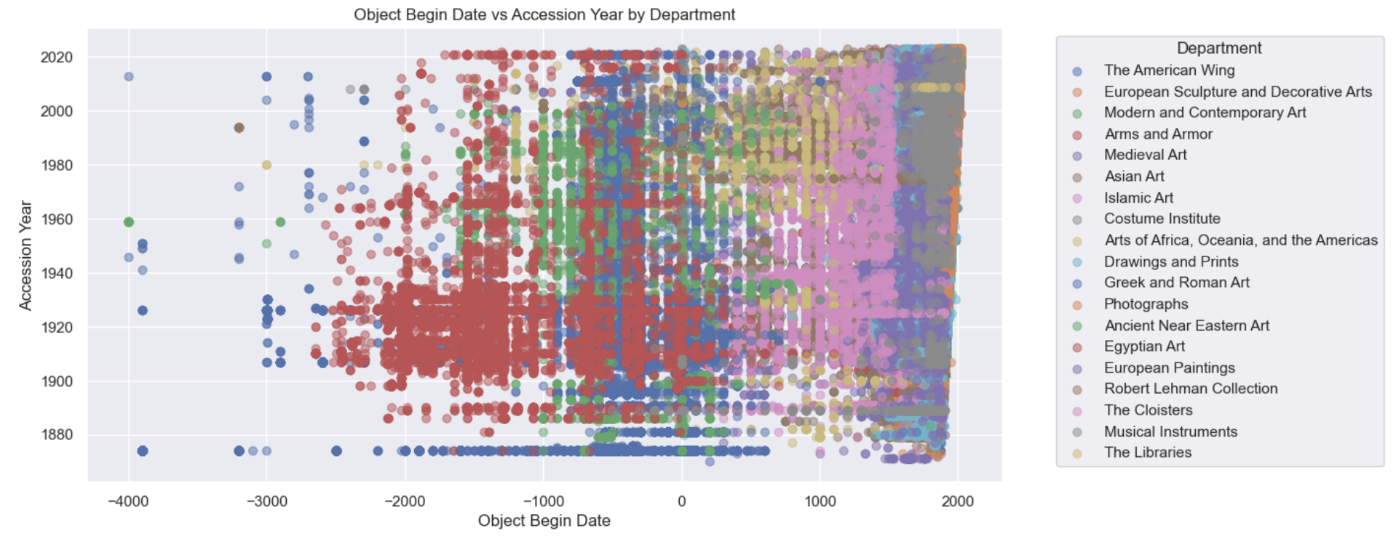
Notes:
GABE SLIDE: Here you can see where different departments are evolving over time
Insights from the Graph
The graph titled "Object Begin Date vs Accession Year by Department" provides several valuable insights:
Temporal Distribution:
The x-axis spans from -4000 to 2025, indicating a wide range of historical dates for the objects. This suggests that the collection includes items from ancient times to more recent periods
Acquisition Trends:
By plotting 'Object Begin Date' against 'Accession Year', the graph can reveal trends in the acquisition of objects over time. For example, clusters of data points might indicate periods when a significant number of objects from a particular era were acquired.
Departmental Focus:
Although specific department labels are not visible, the categorization by department can help identify which departments focus on certain historical periods. For instance, one department might primarily acquire ancient artifacts, while another focuses on more modern pieces.
Historical Coverage:
The graph shows the breadth of historical coverage within the collection. It can highlight gaps or concentrations in certain time periods, helping to understand the strengths and weaknesses of the collection's historical representation.
Collection Diversity:
The diversity of 'Object Begin Date' values across different 'Accession Years' can indicate the variety within the collection. A wide spread suggests a diverse collection, while a narrow range might indicate a more specialized focus.
Specific Insight on Egyptian Art
Egyptian art is heavily collected between the late 1900s up until 1940 and slowly trails off but is still being collected today. However, due to the clustering of data points, this graph type does not provide a clear picture. Reid will cover boxplots and median values that will allow us to dive deeper into the data with more clarity.
These insights can be useful for curators, historians, and researchers to understand the composition and acquisition patterns of the collection, guiding future acquisition strategies and research focus.

Slide 7
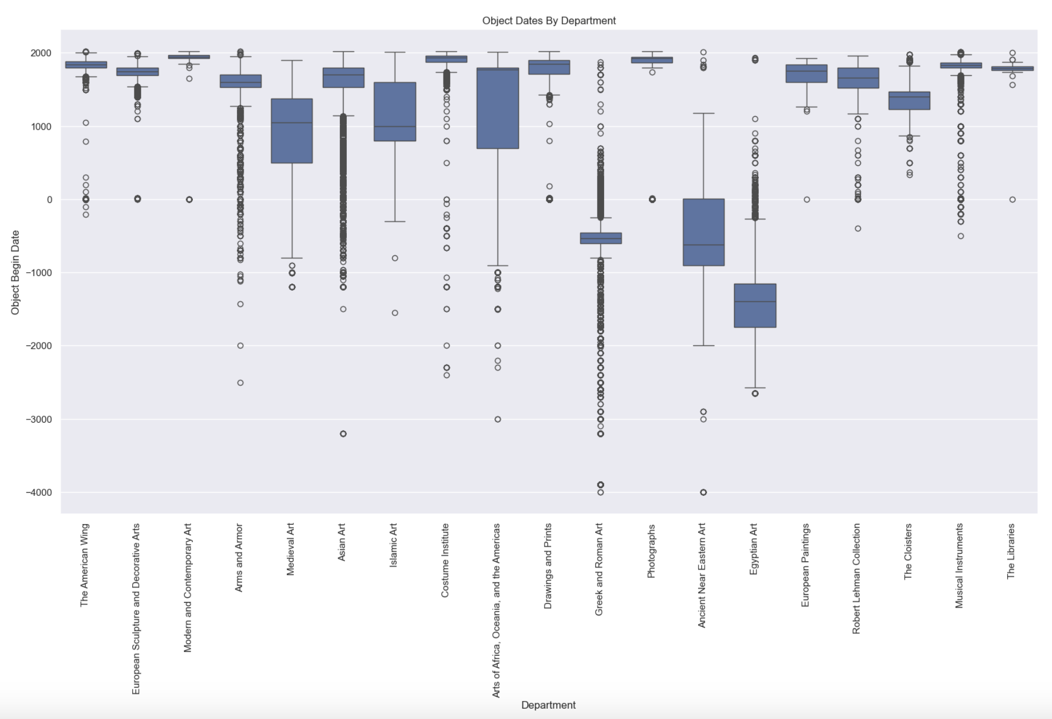
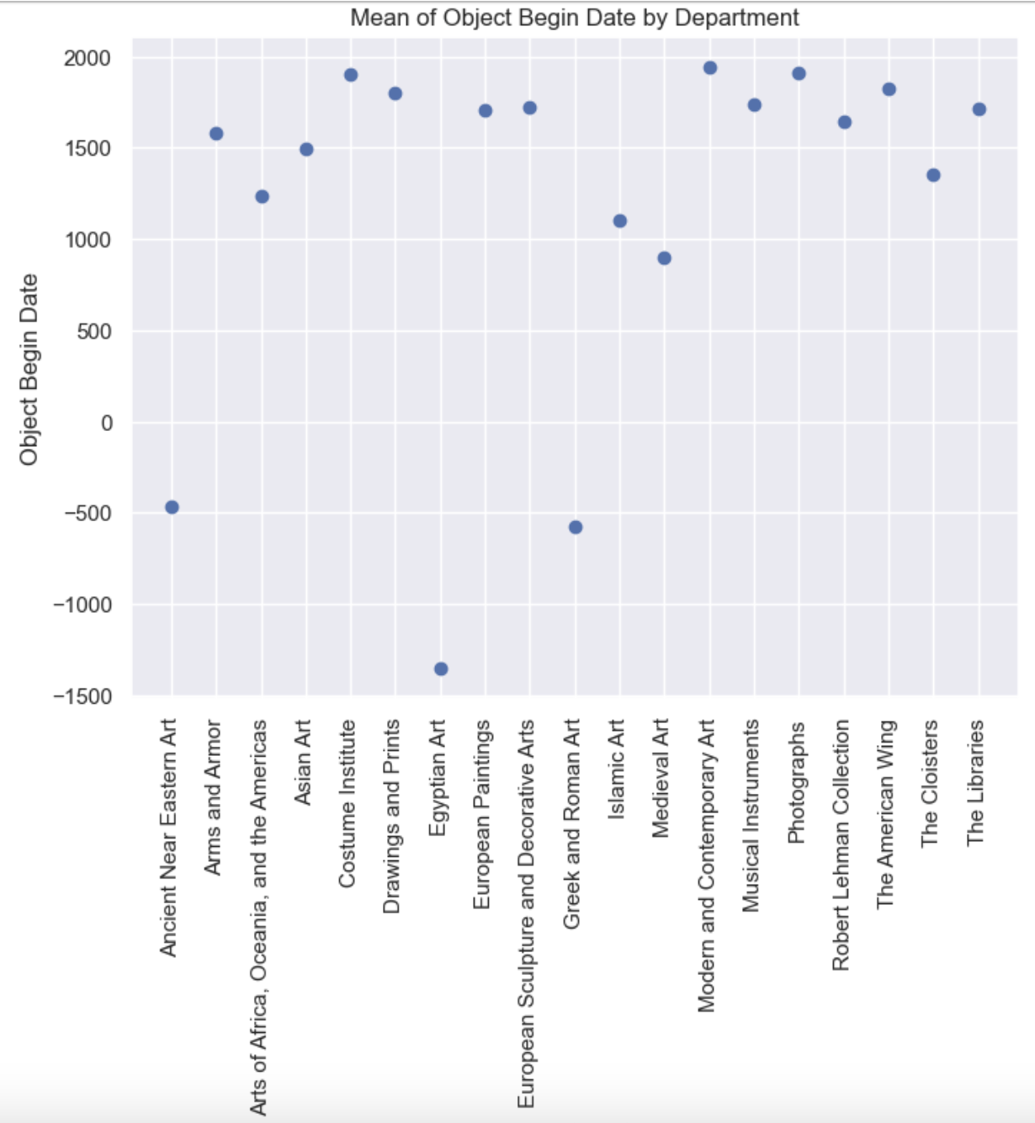
Notes:
REID SLIDE: These box plots especially are critical to analysis. This shows us the relative age per pieces in each department.

Slide 8
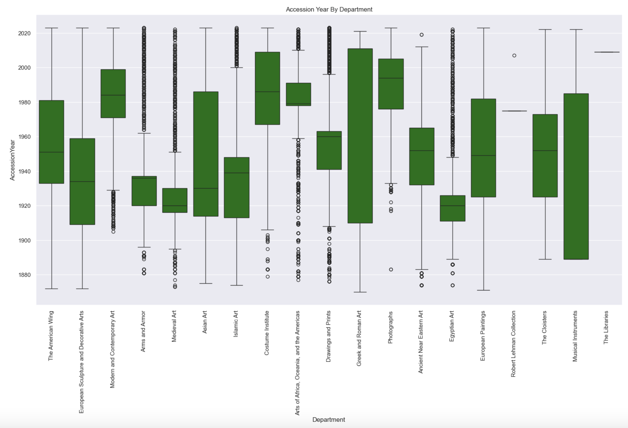
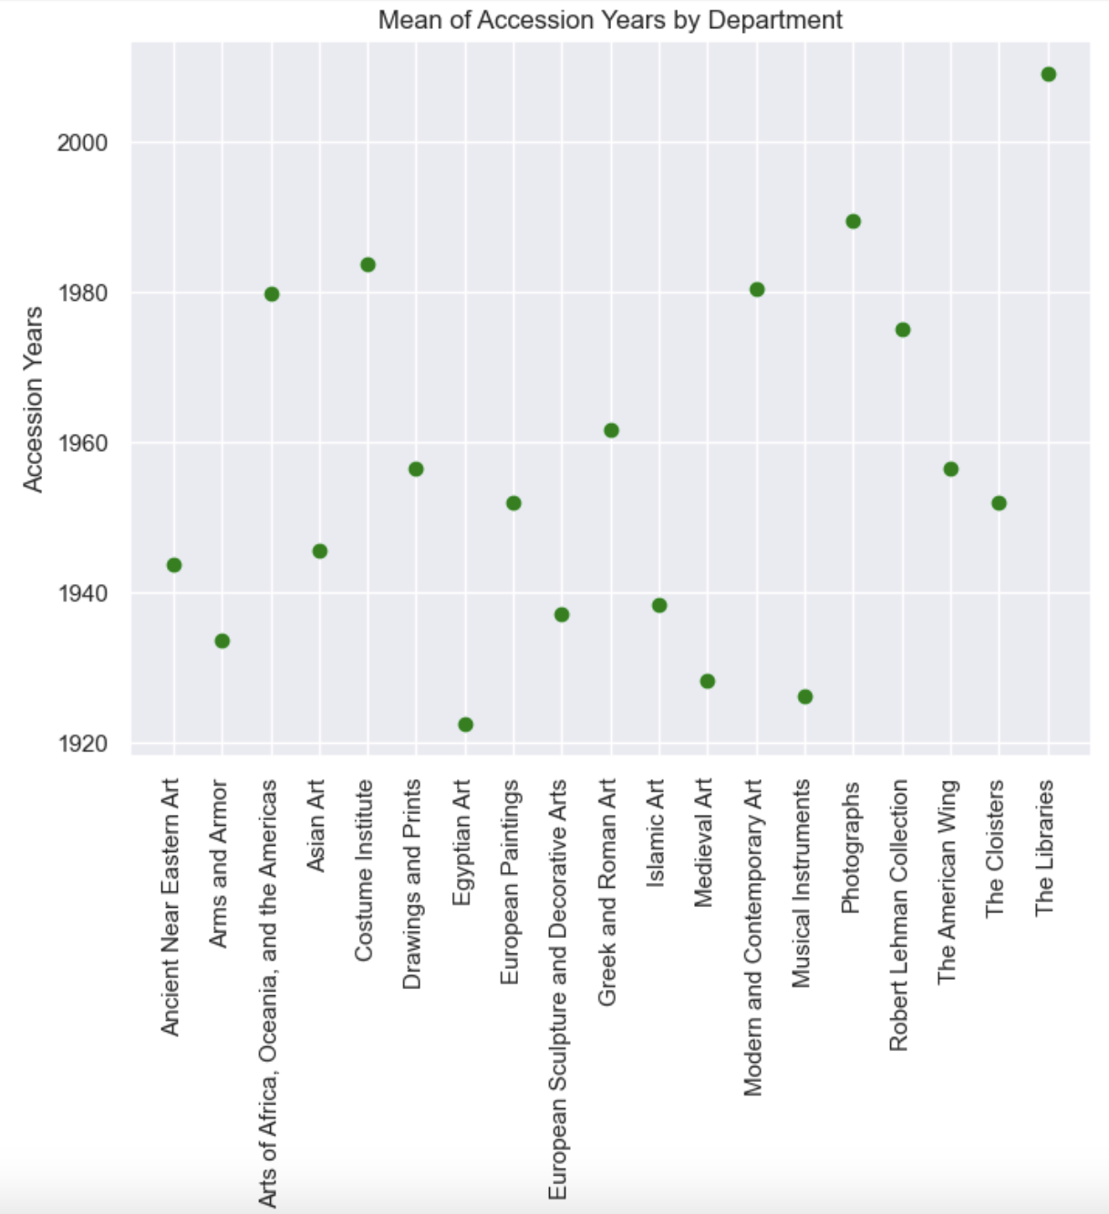
Notes:
REID SLIDE: This tells a great story about the collection. Some things have been consistent over time, some have faded or have become more prevalent now. From arms and armor to the costume institute!

Slide 9
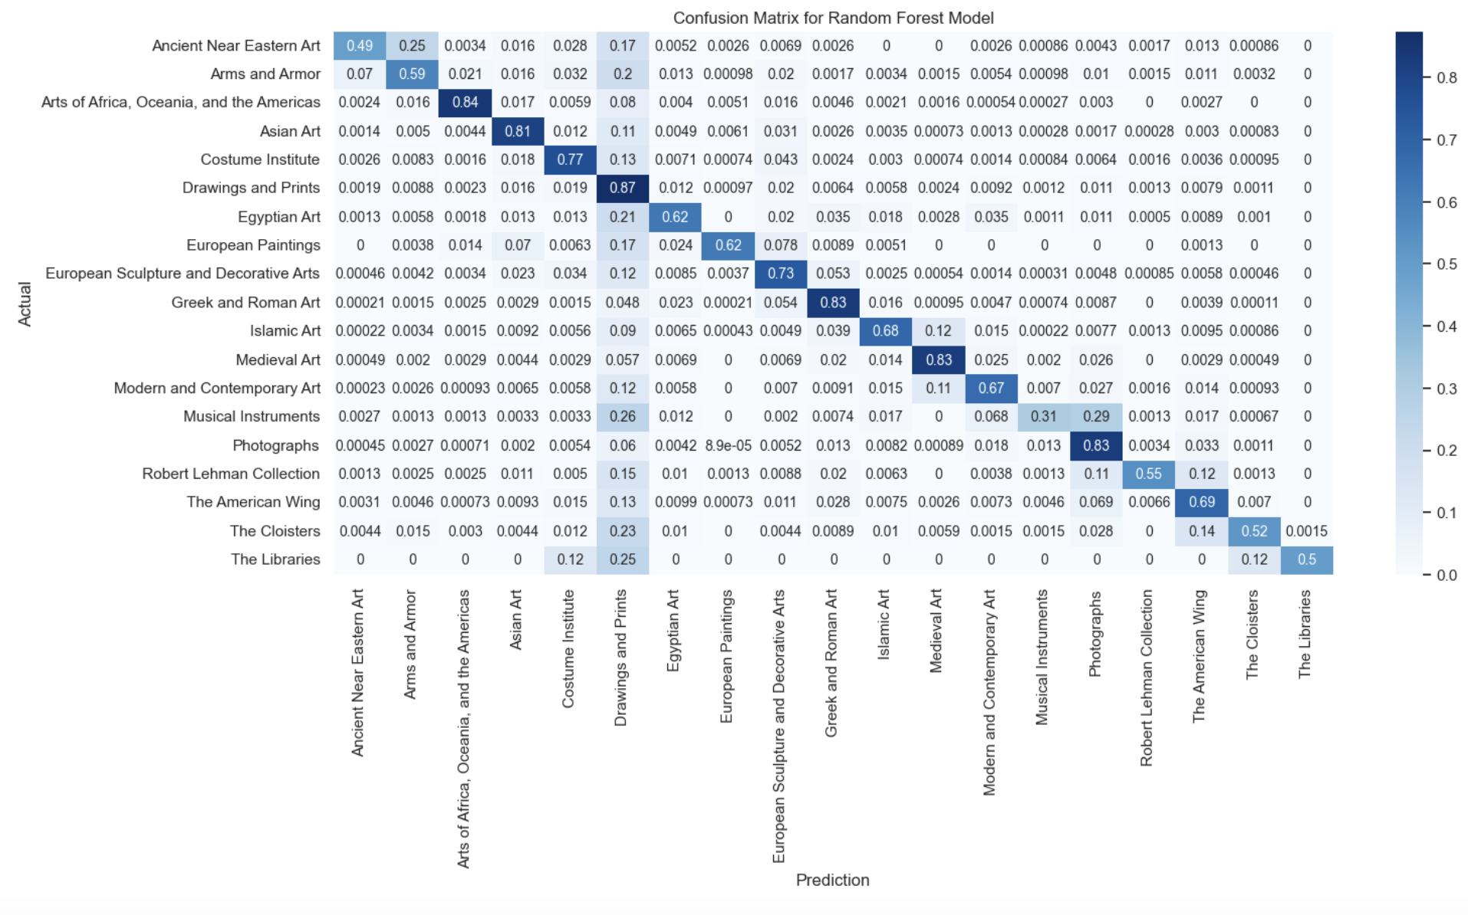
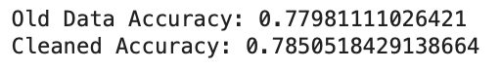
Modeling Potential
Decision Tree and Random Forest models applied to predict department classification
Random Forest always out-performed by 1%-2% margin
Anomalies improved model by minimal amount
Matrix itself reveals information on crossover
Notes:
REID SLIDE: Discuss using the random forest at the end. Makes sense Drawings and Prints could conceivably fit in any other category. Even t

Slide 10
Wrap-Up
The Met department classification system maps well to where models would predict objects to be.
The collection has moved to focusing more on American pieces and non-traditional art such as costuming, photography from traditional pieces
Feature engineering needed to improve messy data
Anomaly detection allows for cleaner analysis
GitHub Repo: https://github.com/gbarela83/COMP-4447-W25-MET_DATA_ANALYSIS
Notes:
REID SLIDE: Wrap-Up Time! Check in if Gabe has any other ideas

